Slide 1
Projet C2NET issu du TG 13 VLab
J. Lamothe
Centre de Génie Industriel, Mines Albi Carmaux
Journées JIAE 2014, Saint Etienne, 15-16 Mai 2014

Slide 2
Projet C2NET Cloud Collaborative Manufacturing Networks
SOUMIS à Appel H2020 Factory of the Future 2014
Topic : Process optimisation of manufacturing assets
Scope : Collaborative and mobile manufacturing
R&I Action
Deadline : March 20 2014
Budget 7,2 M€

Slide 3
L’idée : Cloud Collaborative Manufacturing Networks
The goal of C2NET Project is the creation of cloud-enabled tools for supporting the SMEs supply network optimization of manufacturing and logistic assets based on collaborative demand, production and delivery plans :
Supply chain increase resilience and agility to respond quickly, flexibly and efficiently to changes in demand and unexpected events
Cloud platform
Scalable architecture & platform, real time management of cloud resources
data collection from a wide range of different information sources
real-time picture of different supply chain components
Events detection and analysis of the supply chain
Situation aware tools for optimization and collaboration in the cloud for quick adaptation
Mobile access to decision support services by stakeholders

Slide 4
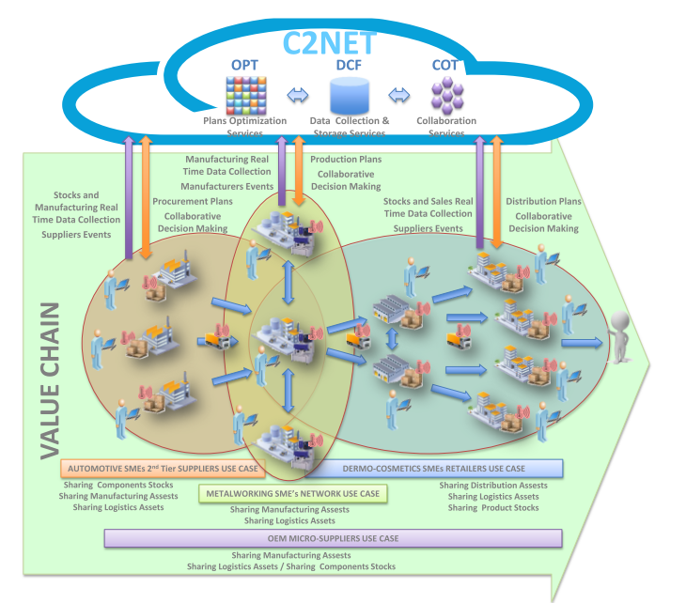
Big Picture

Slide 5
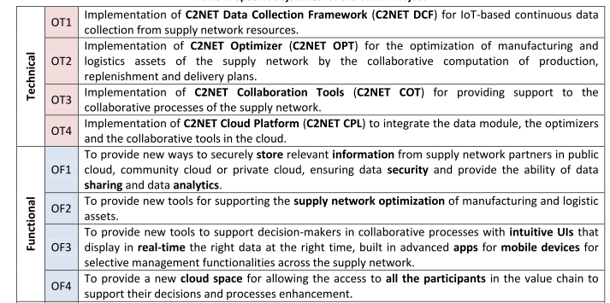
Objectif

Slide 6
Partenaires : porté par le VLAB
ATOS IT SOLUTIONS AND SERVICES SRO (ATOS) | Slovakia | Enterprise
TTY-SAATIO (TUT) | Finland | University
UNIVERSITAT POLITÈCNICA DE VALÈNCIA (UPVLC) | Spain | University
TECMINHO (TECM) | Portugal | Techno Center
IKERLAN S.COOP. (IKERLAN) | Spain | Techno Center
INSTITUTO TECNOLÓGICO DE INFÓRMATICA (ITI) | Spain | Techno Center
ARMINES/ Centre Génie Industriel | France | Research Orga
TEKNOLOGIAN TUTKIMUSKESKUS VTT (VTT) | Finland | Research Orga
UNINOVA | Portugal | Research Orga
FAURECIA AUTOMOTIVE (FAURECIA) | Spain | Enterprise
PIERRE FABRE DERMO-COSMETIQUE (PFDC) | France | Enterprise
(I-VLAB) | Belgium | Association
FLUIDHOUSE OY (FH) | Finland | SME
LINAGORA GRAND SUD OUEST SA (LINA) | France | SME
CAIXA MAGICA SOFTWARE LDA (CMS) | Portugal | SME
FLEXEFELINA (FLEXF) | Portugal | SME
AAMETALOMECANICA (AMM) | Portugal | SME
NOVATEC DISEÑO E INDUSTRIALIZACION S.L. (NOVATEC) | Spain | SME

Slide 7
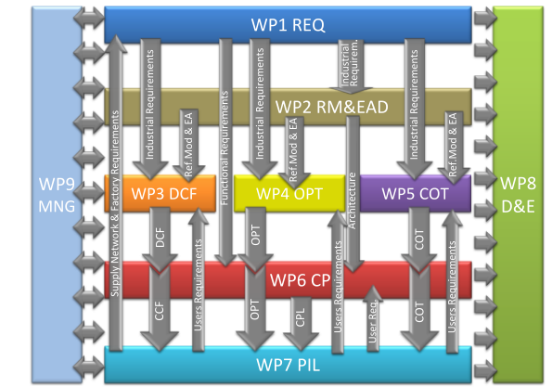
tâches
WP# | WPtitle | leader | P*M | Start | End
WP1 | Industrial Scenarios and Requirements Analysis | IKERLAN | 56 | M01 | M09
WP2 | Reference Model and Elastic Architecture Design | ITI | 106 | M01 | M18
WP3 | Continuous Data Collection Framework | UNINOVA | 107 | M05 | M32
WP4 | Processes Optimization of Manufacturing Assets | UPVLC | 89 | M10 | M30
WP5 | Tools for Agile Collaboration | ARMINES | 92 | M06 | M30
WP6 | Platform and End-to-End Integration | TUT | 133 | M10 | M36
WP7 | Pilots development | VTT | 178 | M19 | M36
WP8 | Dissemination and Exploitation | ATOS | 88 | M01 | M36
WP9 | Project Management | ATOS | 54 | M01 | M36
 |  | Total | 903

Slide 8
4 use cases : big enterprises
Ford-Faurecia – Novatec - Suppliers
Industrie automobile : thermoplastics injection
Agile Collaborative planning & replenishment
Smart sensors & event detections
Real time plan calculation & adaptation
Pierre-Fabre : Usine-Centre distribution –pharmacies
Several trademarks, high seasonality, quick turnover products
Focus group data for analysing the supply chain
Collaborative distribution plan, pull from demand
Promotions, transport => optimized reaction to market events
Real time services for consumers (who has the product ?)
Collaboration marketing-production

Slide 9
4 use cases : SMEs networks
TECM = METALWORKING SME’s network
improves the management of shared logistic resources
Supply & truck transport optimization
Share business opportunities
B Customers-FluidHouse Oy-Micro&Macro suppliers
Hydraulic and lubrication systems for big systems
Heterogeneous suppliers informations systems
Automatically Adapt collaboration to suppliers capabilities
Improve services and planning with business customers
Centralized information hub
Full system information sharing & event detections

Slide 10
Merci de votre écoute Questions ?
La suite l’an prochain
SI C2NET ACCEPTé

Slide 11
Bilan IESA
Programme
Conférence : 5 keynotes, 10 sessions, 40 papiers
6 Workshops : 32 communications
3 : Applications of Advanced Technologies in the Context of Disaster Relief and Crisis Management
4 : Future Internet Methods, Architectures and Services for Digital Business Innovation in Manufacturing, Health and Logistics Enterprises
6 : Collaboration Issues for City-Logistics
6 : Standardisation Developments for Enterprise Interoperability and the Manufacturing Service Domain
8 : ICT Services and Interoperability for Manufacturing
5 : SmartNets – Collaborative Development and Production of Knowledge-Intensive Products and Services
Doctorial symposium : 4 papiers
Participants : 120 participants
72 Workshop & Doctorial, 77 Conférence
31 Phd, 86 Autres
71 Early / 49 Late

Slide 12
Bilan Budget I-ESA 2014 Albi
Budget équilibré (tout juste) aux alentours de 45 k€
Pas définitif : il manque quelques recettes et dépenses
Expenses |  | Incomes
materials for attendees | 3,5 | 42 | enregistrement
materials | 15,1 | 3,8 | sponsor
keynotes | 2,9
pauses | 1,9
Repas | 10,1
Administration logistics | 12
Total | 45,5 | 45,8

